Slide 1

Organizational Behavior
(MGT-502)
Lecture-31

Slide 2
Summary of
Lecture-30

Slide 3
Characteristics Common to All Organizations
Hierarchy of authority
Coordination of effort
Division of labor
Common goal

Slide 4
Organizational Structure and Design
Organizational Structure
  The formal pattern of how people and jobs are grouped in an organization.
Organizational Design
  The decisions and actions that result in organizational structure.

Slide 5
Organization Structure: Its Determinants and Outcomes
Causes
Strategy
Size
Technology
Environment
determines
Structural
designs
leads to
Mechanistic
Organic
Moderated by
Individual
Differences
Performance
and
Satisfaction

Slide 6
Six Key Questions That Managers Need to Answer in Designing the Proper Organizational Structure
The Answer
The Key Question Is Provided By
1. To what degree are tasks subdivided into separate jobs?
On what basis will jobs be grouped
together?
To whom do individuals and groups report?
4. How many individuals can a manager
efficiently and effectively handle?
Where does decision -making authority lie?
6. To what degree will there be rule and
regulations to direct employees and managers?
Work specialization
Departmentalization
Chain of command
Span of control
Centralization and
decentralization
Formalization

Slide 7
Organizational Design Components
Components
Design Decisions
Division of Labor
Specialization
High
Low
Authority
Delegation
High
Low
Departmentalization
Basis
Homogenous
Heterogeneous
Span of Control
Number
Few
Many

Slide 8

Organizational Design Models
The Mechanistic Model
The Organic Model
The Matrix Model

Slide 9
Strategy
Organization
Size
Why Do
Structures
Differ?
Technology
Environment

Slide 10
Today’s Topics

Slide 11
The Basics of Organizational Structure
Organizational structure defines how job tasks are formally divided, grouped, and coordinated.
The organization chart is a visual representation of this division, grouping, and coordination.

Slide 12
Designing an Organization Structure
Basic Steps
1.
Managers must decide how to divide the overall tasks of the organization into successively smaller jobs.
2.
Managers must decide the basis by which to group the individual jobs.
3.
Managers must decide the appropriate size of the group reporting to each supervisor
4.
Managers must distribute authority among the jobs.

Slide 13
Three Types of Relationships:
Direct single
  Between a manager and each subordinate individually
Direct group
  Between a manager and each possible permutation of subordinates
Cross
  Between subordinates and other subordinates

Slide 14
Three Types of Authority
Defines the relationship between superior and subordinate.
Line Authority
Is the authority to serve in an advisory capacity.
Staff Authority
Permits staff managers to make decisions about specific activities performed by employees within other departments.
Functional Authority

Slide 15
Elements of Organizational Structure
Department-
alization
Span of
Control
Organizational
Structure
Elements
Formalization
Centralization

Slide 16
Common Organizational Design
Simple Structure
Bureaucracy
Matrix Structure

Slide 17
Simple Structure
A structure characterized by a low degree of departmentalization, wide spans of control, authority centralized in a single person, and little formalization.

Slide 18
The Simple Structure
Abid’s Store
Abid
Owner, manager
Farooq
Sajjad
Shakir
Rafiq
Riaz
salesperson
salesperson
salesperson
salesperson
Cashier

Slide 19
Few
Departments
Wide Spans
of Control
The Simple Structure
Little
Formalization
Centralized
Authority

Slide 20
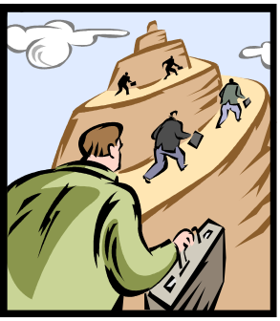
Bureaucracy
A structure with highly routine operating tasks achieved through specialization, very formalized rules and regulations, tasks that are grouped into functional departments, centralized authority, narrow spans of control, and decision making that follows the chain of command.

Slide 21
The
Bureaucracy
Functional
Structure
Divisional
Structure

Slide 22
The Bureaucracy
Strengths
  Functional economies of scale
  Minimum duplication of personnel and equipment
  Enhanced communication
  Centralized decision making
Weaknesses
  Subunit conflicts with organizational goals
  Obsessive concern with rules and regulations
  Lack of employee discretion to deal with problems

Slide 23
Matrix Structure
A structure that creates dual lines of authority and combines functional and product departmentalization.

Slide 24
The Matrix Structure
Cross-Functional
Coordination
Clear
Accountability
Dual Chain
of Command
Allocation
of Specialists

Slide 25
Choosing an Appropriate Structure
A structure should be chosen that best supports the organization’s strategy.
There are trade-offs in any choice of structure.
After the strategic priorities are noted, however, this should help determine which tradeoffs to make.

Slide 26
Simple Structure
Owner / Manager
Owner/Manager makes all major decisions directly and monitors all activities
Difficult to maintain this structure as the firm grows in size and complexity
Notes:
6

Slide 27
Functional Structure
An organizational structure that groups together people who hold similar positions, perform a similar set of tasks, or use the same kinds of skills.

Slide 28
Functional Organizational Structure
Organizes employees around skills or
other resources (marketing, production)
President
Finance
Production
Marketing

Slide 29
Departmentation by Function
Advantages
  Efficiency within functions
  Clear lines of authority
  Resource centralization
  Everyone speaks the same language
Disadvantage
  With wide range of products or services, various functions can have difficulty efficiently servicing needs
  Poor coordination across departments
  Slow response to customer problems

Slide 30
Functional Departmentalization
Hajira
Company
Engineering
Marketing
Finance
Personnel
Manufacturing
Major Advantage
  Creating efficiency and more cost effective units
Major Disadvantage
  Sacrificing organizational goals for departmental ones

Slide 31
Functional form trade-offs
Advantages
Achieve greater specialization
Present a single face to vendors and customers
Reduces duplication
Best for managing a single product or service.
Disadvantages
Not conducive to multiple product lines or customer segments.
Inhibits communication between functions.

Slide 32
Functional Structure
Chief Executive Officer
Corporate R&D
Corporate Finance
Strategic Planning
Corporate Marketing
Human
Resources
Sales &
Marketing
Human
Resources
Finance
Production
Engineering
Accounting
Notes:
18

Slide 33
Product Departmentalization
Hajira
Company
Small
Household
Appliances
Large
Household
Appliances
Commercial
Appliances
Major Advantages
  Creating profit responsibility
  Fostering innovation and autonomy
Major Disadvantages
  Creating redundant functions
  Increasing administrative costs

Slide 34
Departmentation by Product
Advantages
  Better coordination across functions
  Faster product development
  Closer to customer
  Focus on product
Disadvantages
  Product lines can overlap or cross-purposes
  Less clear lines of authority
  Conflict over division of shared resources
Works best in large organizations with many product lines

Slide 35
Product Structure Trade-offs
Advantages
Depresses product development time
Disadvantages
Duplicates resources such as R&D and marketing
Customers may want to buy from numerous product divisions

Slide 36
Territorial Departmentalization
Hajira
Company
Eastern
Southern
Rocky
Mountain
Pacific
Midwestern

Slide 37
Geographic Structure Trade-offs
Advantages
Can be close to the customer geographically to provide on-site service and JIT delivery.
Reduces transportation costs.
Disadvantages
Duplication of activities (e.g., R&D)

Slide 38
Customer Departmentalization
Hajira
Company
Retail
Stores
Mail
Order
Institutional
Sales
Government
Contracts

Slide 39
Project-Based Matrix Structure
Employees are temporarily assigned to a specific
project team and have a permanent functional unit
President
Engineering
Manager
Marketing
Manager
Software
Manager
Project A
Manager
Project B
Manager
Project C
Manager

Slide 40
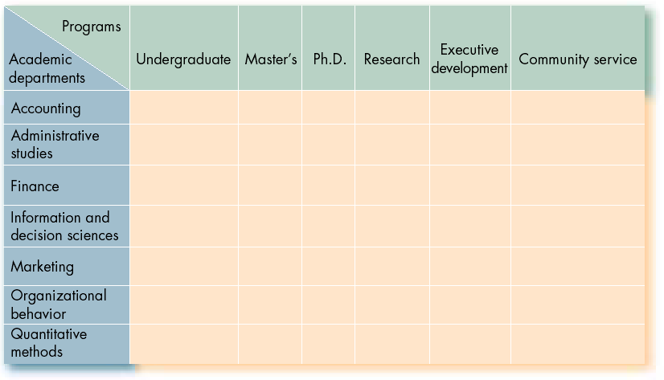
Matrix Structure (College of Business Administration)
(Director)
(Dean)
Employee

Slide 41
Matrix
Organizational Design
Rejects the unity of command principal
Uses multiple authority structures, so that many people report to two managers
People from different functional areas work on various projects

Slide 42
The Horizontal Structure
President
Vice President
R & D
Vice President
Finance
Vice President
HRM
Core Process Team
Core Process Team
Core Process Team

Slide 43
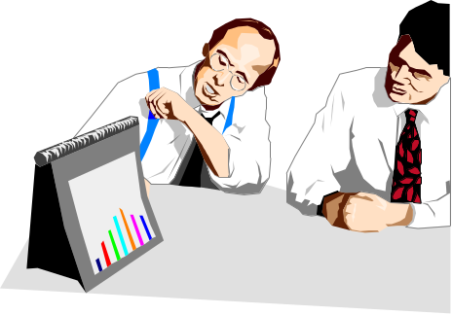
A Look to the Future: Virtual Organizations
One of the fastest developing practices in business throughout the world involves firms in cooperative relationships with their suppliers, distributors, and even competitors.

Slide 44
The Virtual Organization
Independent R & D
Consulting Firm
Advertising
Agency
Executive
Group
Factories in
China
Commissioned
Sales Representatives

Slide 45
Network Organizational Structure
Product
Development
Firm
(France)
Marketing
Firm
(U.K.)
Core
Firm
Pakistan
Customer
Service
Firm
(Canada)
Production
Firm
(China)
Accounting
Firm
UAE

Slide 46
The Distinguishing Feature of Job Design in the Future
Flexibility

Slide 47
Structures in the Dot-com, Global Workplace
Dot-com companies have organic, flexible structures, which may become more formalized as they grow.
Joint ventures are popular as a way to gain entry into foreign markets.

Slide 48
Emerging Issues in Design of Work
Telecommuting - employees work at home or in other locations geographically separate from their company’s main location
Alternative work patterns
  Job Sharing - an alternative work pattern in which there is more than one person occupying a single job
  Flextime - an alternative work pattern that enables employees to set their own daily work schedules

Slide 49
Emerging Issues in Design of Work
Technology at work
  Virtual Office - a mobile platform of computer, telecommunication, and information technology and services
  Technostress - the stress cause by new and advancing technologies in the workplace
Task Revision - the modification of incorrectly specified roles or jobs
Skill development

Slide 50
Evolving Forms of
Organizational Design
Several new forms of organizational design
  Self-managing teams
  Team-based approach
  The virtual organization

Slide 51
The Team-Based
Structure
Empower
Workers
Hold Teams
Accountable

Slide 52
Organizational Designs
and Employee Behavior
Work
Specialization
Span
of Control
Centralization

Slide 53
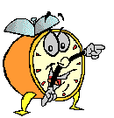
Let’s stop it here

Slide 54
Summary

Slide 55
Elements of Organizational Structure
Department-
alization
Span of
Control
Organizational
Structure
Elements
Formalization
Centralization

Slide 56
Common Organizational Design
Simple Structure
Bureaucracy
Matrix Structure

Slide 57
The Distinguishing Feature of Job Design in the Future
Flexibility

Slide 58
Evolving Forms of
Organizational Design
Several new forms of organizational design
  Self-managing teams
  Team-based approach
  The virtual organization

Slide 59
Next….

Slide 60
Organizational Behavior
(MGT-502)
Lecture-31

